Slide 1
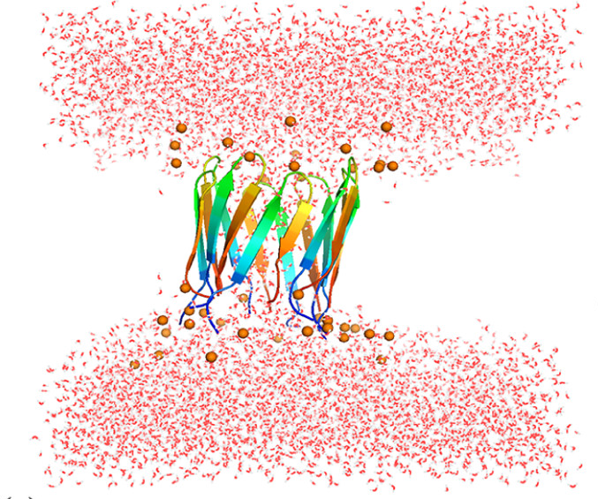
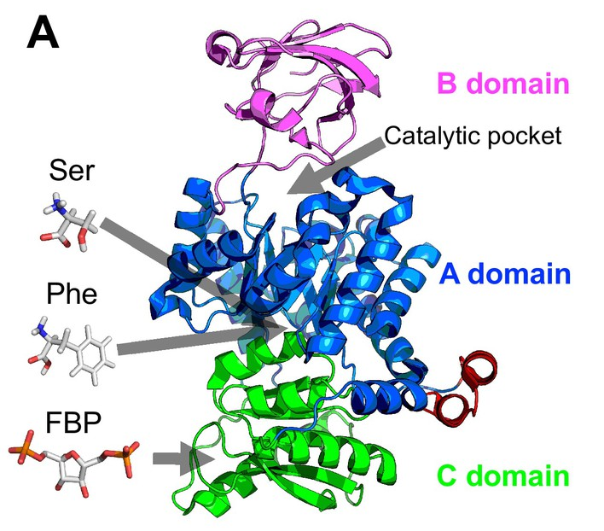
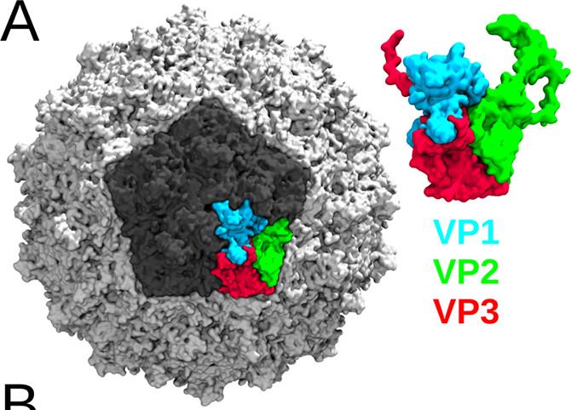
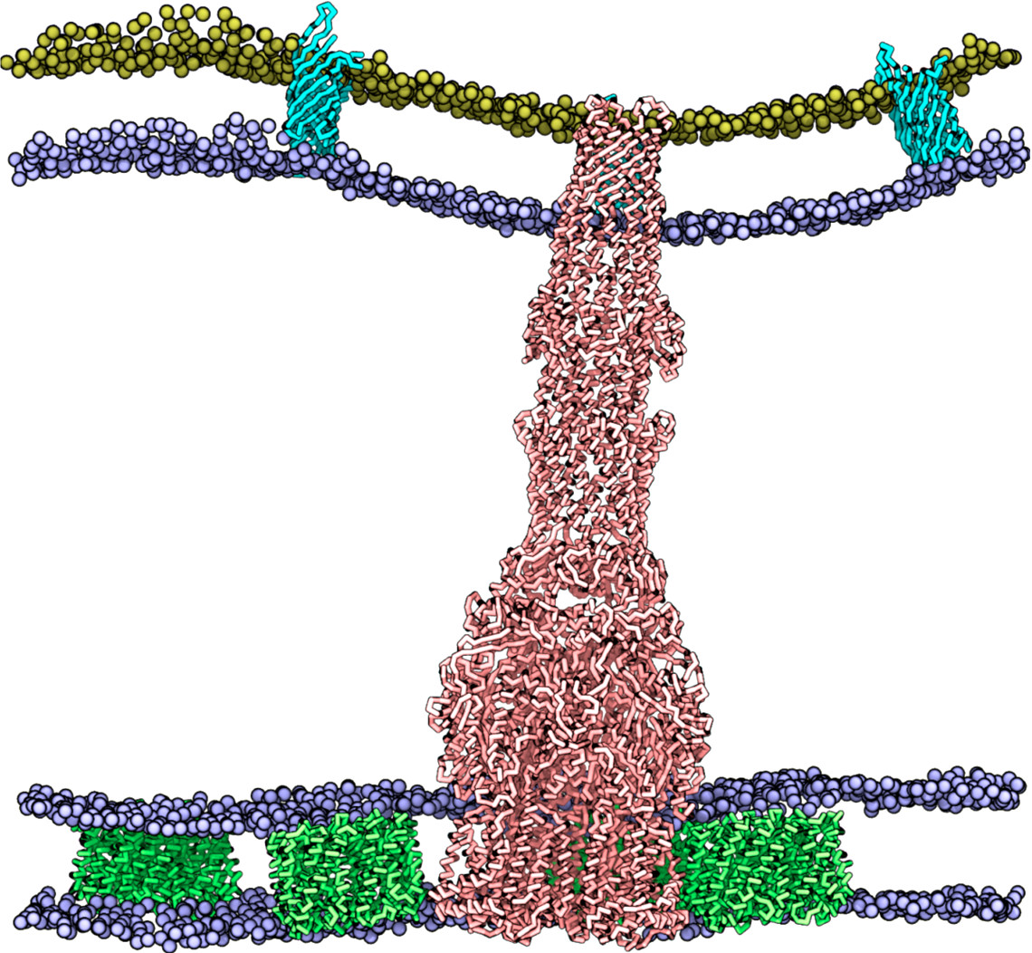
Description | Representative force fieldsg (and limitations)g |  | Examples
QM/MM | HF approach DTF approach | up to 100 QM atoms
POLARISABLE ALL-ATOMS | AMOEBA AMBER ff02 -CHARMM | 20 nm - less than 100 ns 20 nm - up to 100 ns 20 nm - up to 500 ns
ALL-ATOMS | CHARMM AMBER OPLS | 20 nm size up to 1 μs
UNITED ATOMS | GROMOS OPLS | 20 nm size up to 1 μs
POLARISABLE COARSE GRAIN | ELBA | 20-30 nm size up to 1-5 μs
COARSE GRAIN | SIRAH MARTINI | 20-30 nm - 10 μs 50 nm - 1-10 μs
COARSE GRAIN + MEAN FIELD | OCCAM | 20-30 nm size up to 10 μs
IMPLICIT SOLVENT | approach GB approach | up to 100 nm and 10 μs (model dependent)
Drude
SPEED ACCURACY
SASA

